Slide 1

BlackJack
Loading … 30%
(Week #6 of 17)
Weekly demo
Arnold BARNA
2017-10-20

Slide 2
My Topics
Class structure for the game
Using properties (mostly bools)
Using unit tests

Slide 3
Classes
Game
Card(s)
Deck
Hand(s)
Card(s)
Motto: “Everybody minds only their own business”

Slide 4
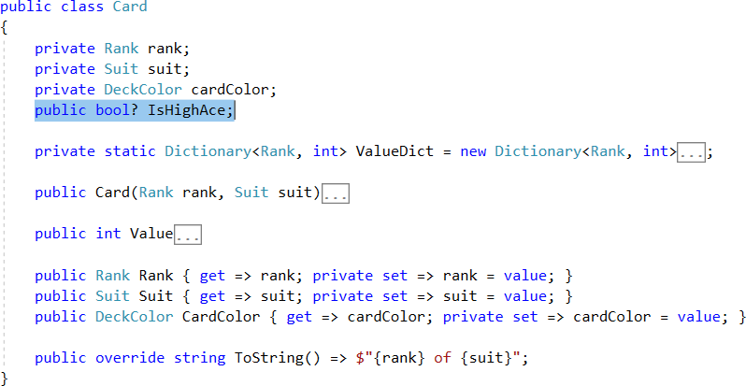
Card class with a Nullable bool

Slide 5
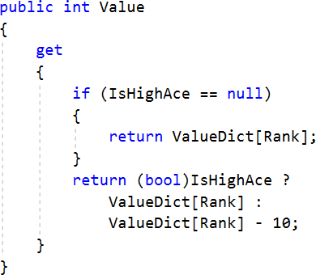
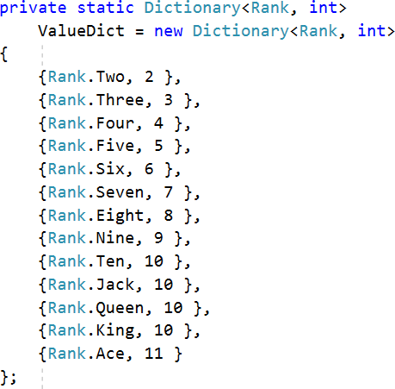
Using Nullable bool in Card class

Slide 6

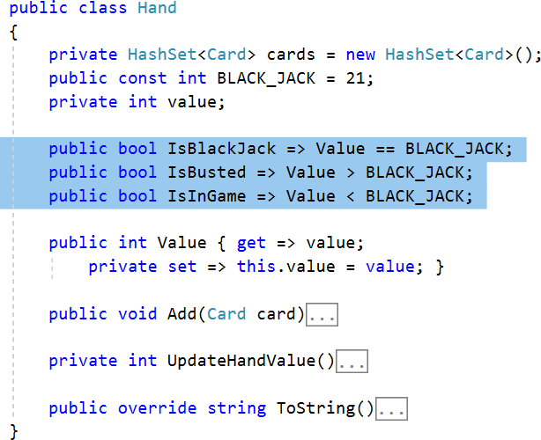
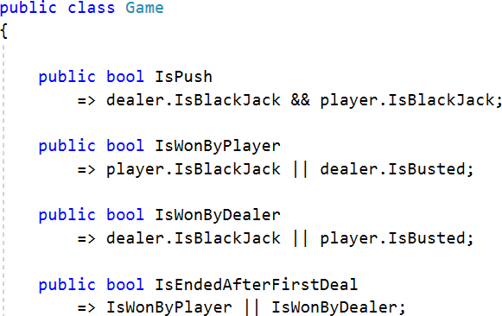
Properties in Hand class

Slide 7
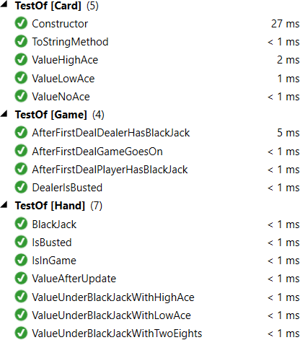
NUnit Tests with LOCs
 | Class | Test | Test vs Class
Card | 64 | 69 | +8%
Hand | 76 | 85 | +12%
Deck | 81 | No test yet ☹ | n/a
Game | 98 | 81 (not enough!) | -17%

Slide 8
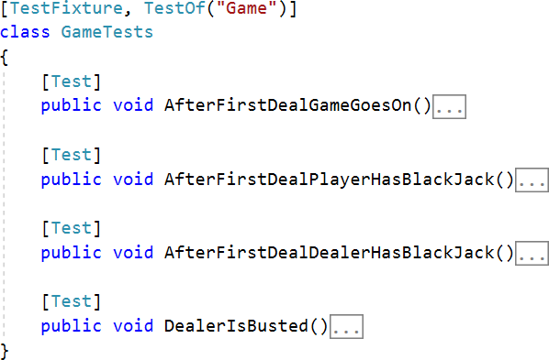
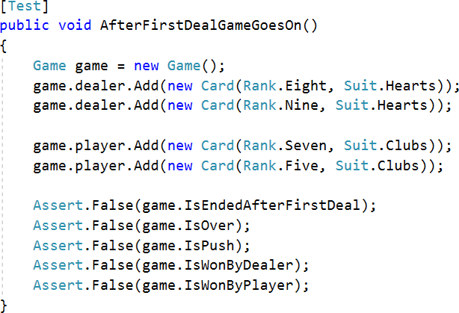
NUnit Tests for Game class

Slide 9
Thank you for the attention
Available on GitHub:
Code:
https://github.com/greenfox-academy/bramble100/tree/master/week-07/
Slides:
https://github.com/greenfox-academy/bramble100/tree/master/week-07/demo

